Slide 1
Sentiment Analysis of Social Media Content: Group 5
Team:
Affan Arif Khamse (ak10529)
Rui Gao (rg4639)
Tarik Kassa (tk2766)
Francisco Suazo (fjs9244)
12/04/2024

Slide 2
Agenda
Description of the project
Project Timeline
Problem statement
Data Exploration
Visualizations
Predictive Modelling

Slide 3
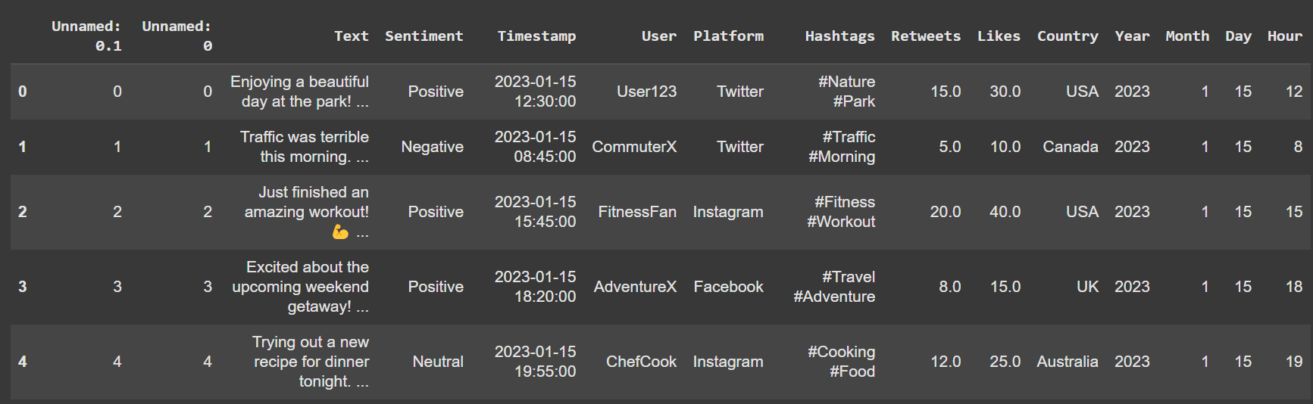
Description of the project
This project aims to analyze user-generated content across various social media platforms to uncover sentiment trends and user behavior.
The dataset offers a rich source of data, including text-based content, user sentiments, timestamps, hashtags, user engagement metrics (likes and retweets), and geographical information.
By exploring this data, we can identify how emotions fluctuate over time, platform, and geography.
We will also investigate the correlation between popular content and user engagement metrics

Slide 4
Project Timeline
Initial Modeling
Hypothesis Testing
Final Model Training and Interpretation
Dataset Exploration
EDA & Visualization
Week 5
Week 9
Week 1-4
Week 6-8
Mid-Program Presentation
Final Presentation

Slide 5
Problem Statement
The project aims to analyze sentiment in user-generated content, uncover temporal trends and investigate platform-specific user behavior.
By identifying popular topics via hashtags, exploring engagement levels, and understanding time differences in sentiment trends, the analysis seeks to provide actionable insights into audience behavior and content dynamics.

Slide 6
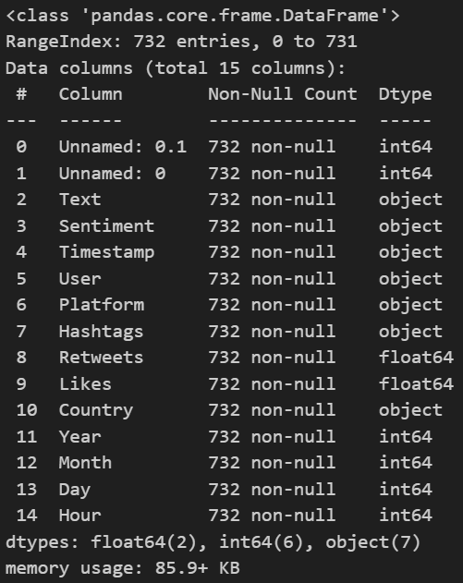
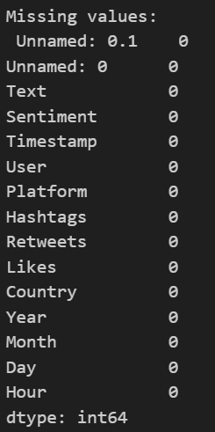
Data Exploration
The primary goal is to perform sentiment analysis, investigate temporal and geographical trends in user-generated content, and analyze platform-specific user behavior. The project will focus on identifying popular sentiments through platforms, exploring engagement levels, and understanding regional sentiment trends across time.

Slide 7
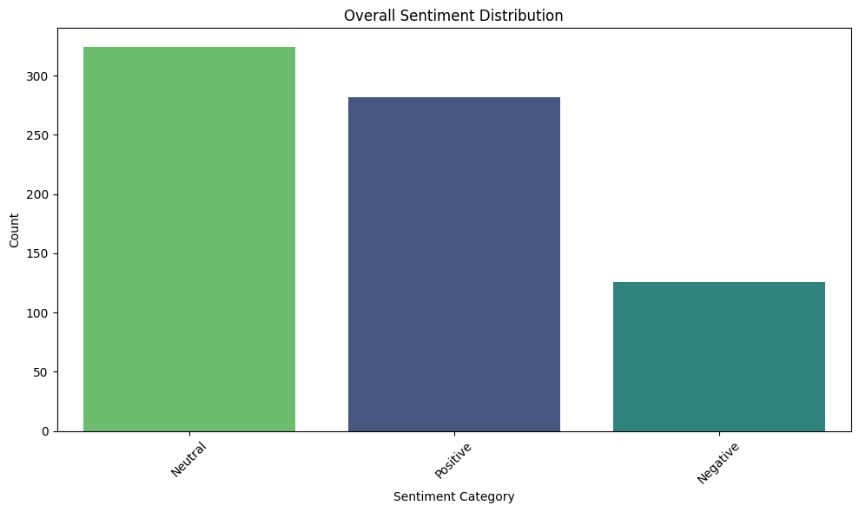
Visualizations
Distribution of Neutral, Positive, and Negative sentiments in the dataset.
Neutral sentiment dominates, followed by Positive, with Negative being the least common.
Highlights a general trend of balanced or positive user-generated content.

Slide 8
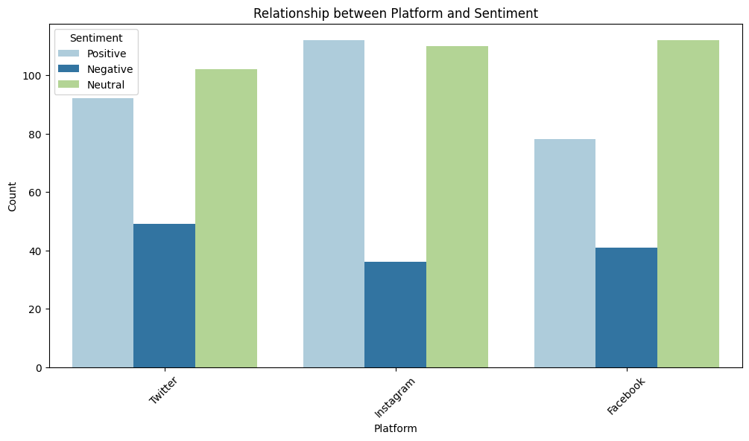
Visualizations
Relationship Between Platform and Sentiment, showing sentiment distributions across Twitter, Instagram, and Facebook.
Neutral sentiment dominates across all platforms, particularly on Instagram and Facebook.
Positive sentiment is most prominent on Twitter compared to the other platforms.
Negative sentiment is relatively low but consistent across all platforms, with slightly higher counts on Twitter.

Slide 9
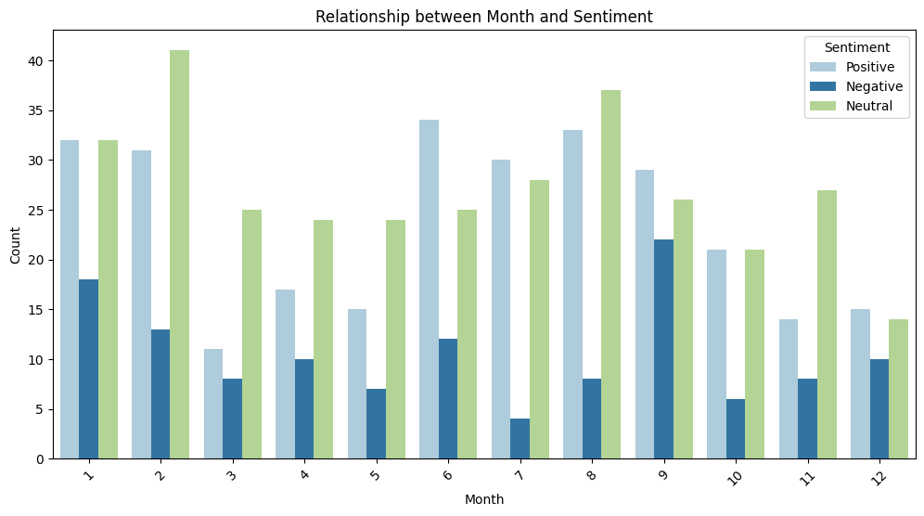
Visualizations
Monthly sentiment analysis reveals predominantly positive sentiment, with peaks in months 6 and 9
Neutral sentiment shows high variability
Negative sentiment maintains lowest levels overall

Slide 10
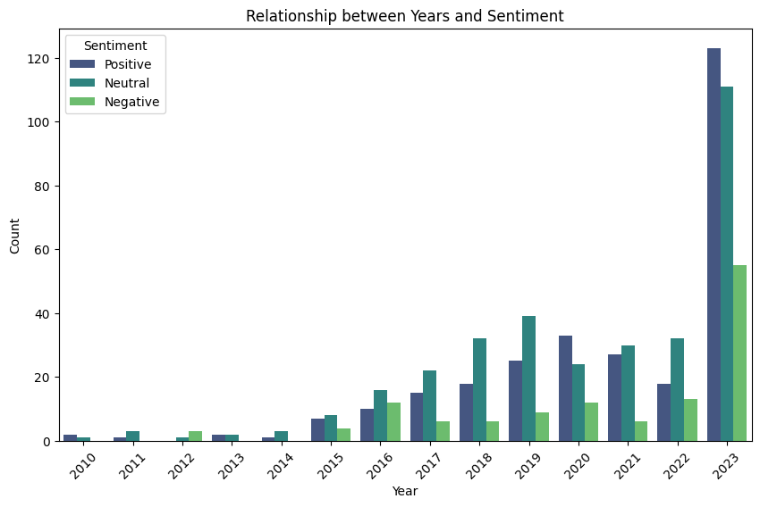
Visualizations
Significant growth in sentiment analysis from 2015-2023, with a spike in 2023
Consistently higher positive and neutral sentiment compared to negative sentiment
Early years (2010-2015) show minimal sentiment activity across all categories

Slide 11
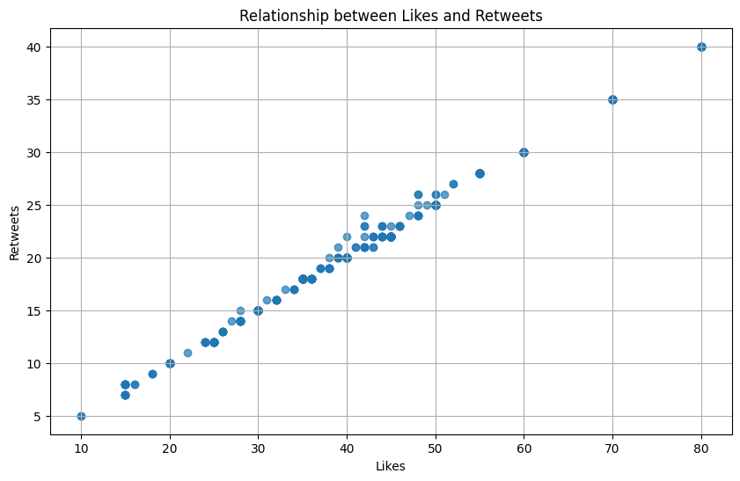
Visualizations
Scatterplot depicting the Relationship Between Likes and Retweets, showing a clear positive correlation.
As the number of Likes increases, the number of Retweets also tends to increase.
The linear trend indicates strong engagement consistency, where posts with higher likes are likely to receive more retweets.
The data suggests that Likes may serve as a good predictor of Retweet behavior, making it an important metric for understanding content amplification

Slide 12
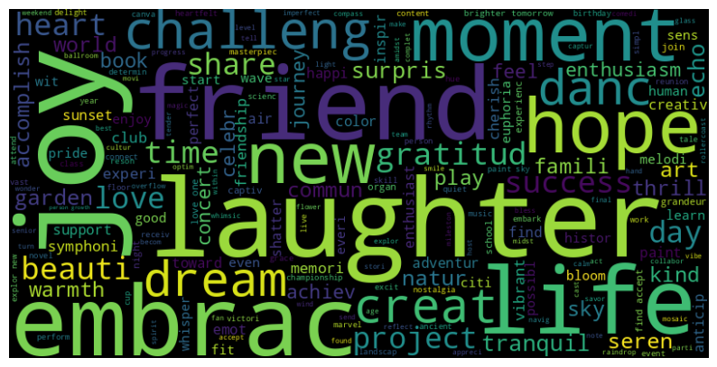
Visualizations
Word cloud illustrating content with positive sentiments are dominant across all platforms

Slide 13
Hypothesis
User-generated content with higher positive sentiment is more likely to receive higher engagement.

Slide 14
Predictive Modelling
Key Features:
Text: Content of the post.
Sentiment: Target variable indicating the sentiment of the post (Positive, Negative, Neutral).
Timestamp: Date and time of the post.
User: Username of the poster.
Platform: Social media platform (e.g., Twitter, Instagram, Facebook).
Hashtags: Associated hashtags.
Retweets: Number of retweets (float).
Likes: Number of likes (float).
Country: Country of origin of the post.
Year, Month, Day, Hour: Timestamp components, which are redundant as they can be derived from Timestamp.

Slide 15
Predictive Modelling
Next steps:
Preprocess the dataset: Handle missing values, convert text to numerical representations (e.g., TF-IDF or embeddings), and normalize numerical features.
Train-test split: Divide data into training and test sets.
Train a machine learning model: Linear Regression and Logistic Regression with Clustering
Evaluate the model: With metrics like accuracy
Fine-tune and interpret results.

Slide 16
Predictive Modelling
Next steps:
Features: Combined representations of text (Sentiment), scaled numerical features (Retweets, Likes), and encoded categorical features (Platform, Country).
Target: Encoded Sentiment.
Training set: 585 samples.
Test set: 147 samples.

Slide 17
Predictive Modelling
Linear Regression:
Sentiment Prediction=0.715+(−0.779)⋅X1​+(1.180)⋅X2​+(0.876)⋅X3​+...
Coefficients:
Mean Squared Error (MSE): 1.87×10^19
Normalized Mean Absolute Error: 4.39×10^8
Normalized Mean Squared Error:: 6.59×10^19

Slide 18
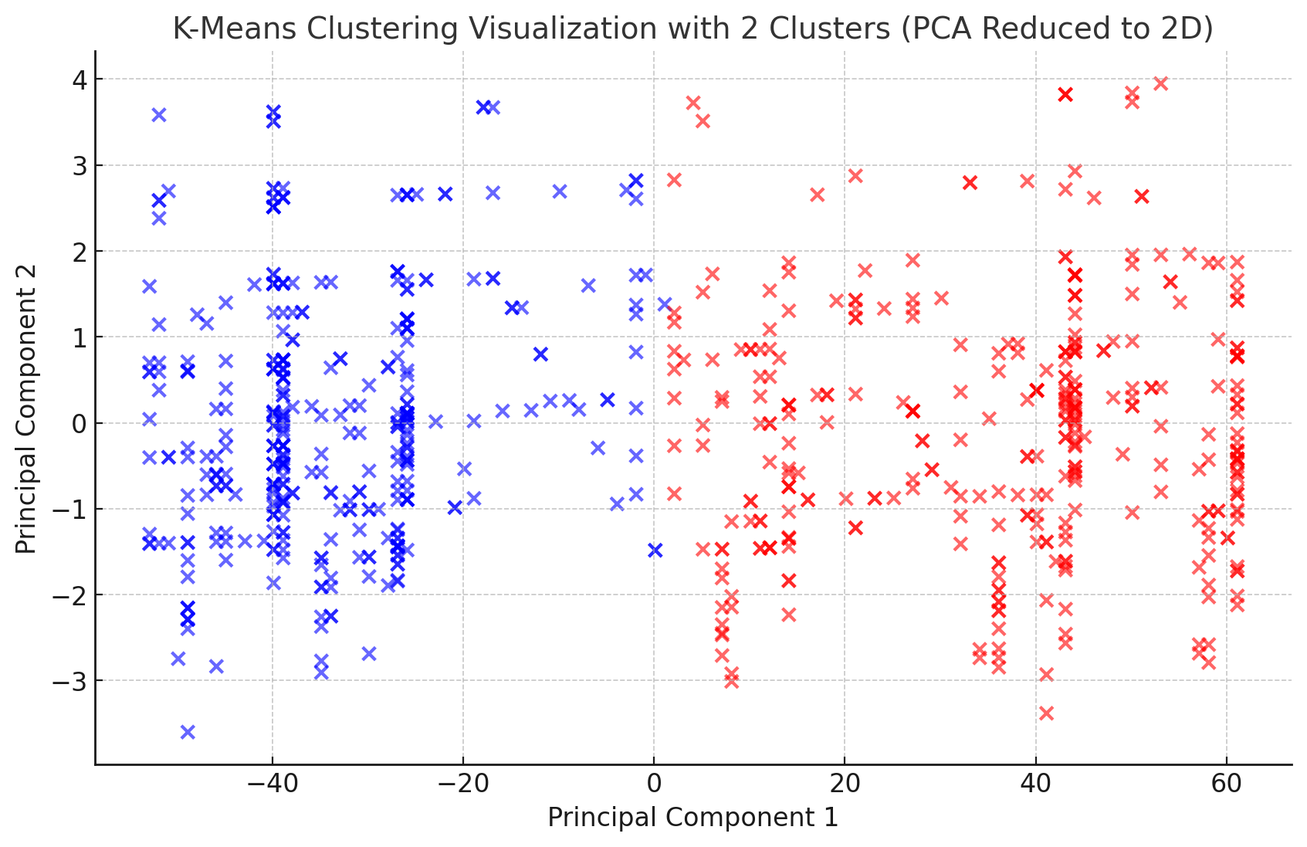
Predictive Modelling
Logistic Regression:
Accuracy: 72.1%
Clustering Results:
Silhouette Score: 0.701 (indicates good separation between clusters).

Slide 19
Predictive Modelling
Hypothesis: "User-generated content with higher positive sentiment is more likely to receive higher engagement."
Testing Engagement Metrics:
Hypothesis Test on Likes:
A t-test comparing likes for Neutral vs. Positive sentiments showed a significant difference (p=1.48×10^−5
Conclusion: Content with Positive sentiment tends to have different (likely higher) engagement compared to Neutral.
The hypothesis is partially supported:
Evidence For:
The t-test revealed statistically significant differences in engagement (likes) for Positive content.
Positive sentiment words like "joy" correlate with engagement.
Challenges:
The models (linear and logistic regression) struggled with accuracy and prediction errors, suggesting feature relationships are non-linear and complex.

Slide 20
Questions?

